Slide 1
AMELA
Zachary Gavin
Kendall Clara
Eli
A. Kaufman COO
M. Kremer CEO
E. Haworth CCO
“L.” Nguyen CFO
A. Zupke CTO

Slide 2
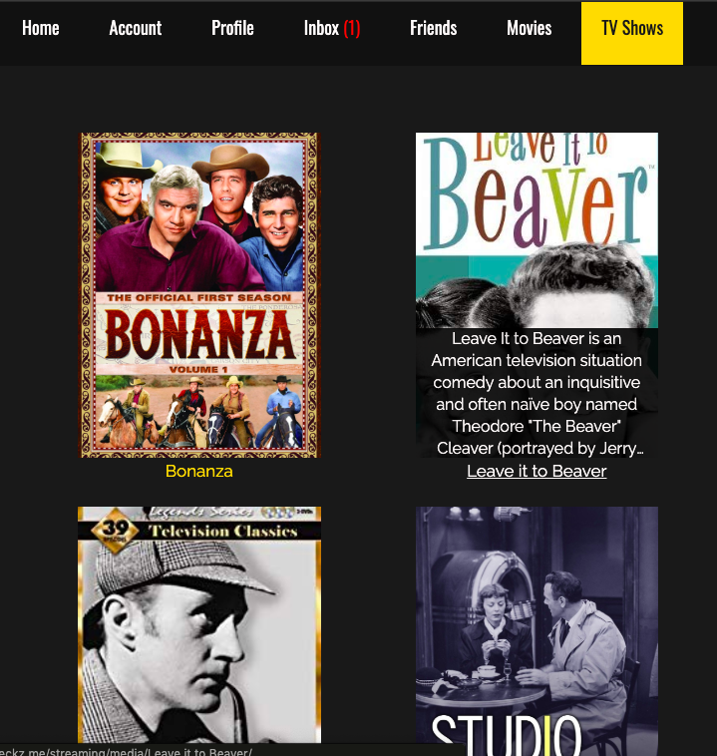
Problem
Create a streaming service that does not limit its offerings
10 subscription slots for television shows that last a month at a base rate
Individual 24-hour movie rentals at additional fees

Slide 3
General Approach
Split into frontend / backend teams
Compartmentalized work to avoid code conflicts
Allows for specialization in a particular feature
Help out other members as necessary
Focus on fulfilling functional requirements
Worked on aesthetics as features were completed

Slide 4


Technologies Used
AWS : All content, code, and data in our project except our media exist in an AWS product.
MySQL : All permanent data, such as logistics, user info, and user submitted content is stored using MySQL, a relational database manager.

Slide 5


Technologies Used
Django : Web framework based on Python. Emphasizes fast development, less code.
JWPlayer : Video player platform that stores and formats media. All media on our site is retrieved and played back through its API.

Slide 6

Technologies Used
HTML & CSS : Our site is almost entirely
HTML and CSS.
Javascript : Used for client side functionality
HTML and CSS could not handle, like
dynamic form elements and cookies.

Slide 7
Features
Streaming Features :
TV subscriptions
Movie rentals
Media playback
Media searching
Description Pages
Social Media Features :
User profiles
User searching and following
Messaging system
Media and profile comments
Media ratings

Slide 8
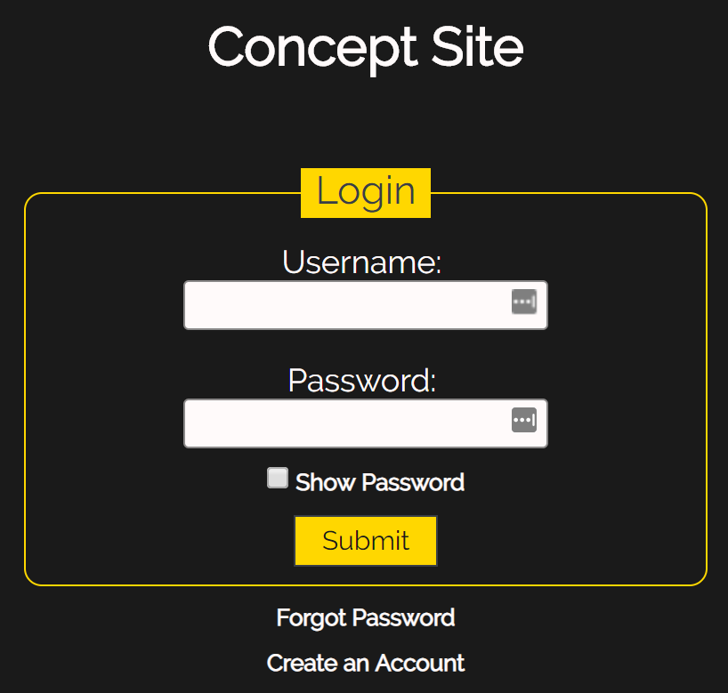
Aesthetic Design & Theme
Simple dark theme with yellow accent color
Emphasis on consistency
Aimed for a streamlined, classic look to minimize visual load
Designed with single click functionality in mind to reduce user’s mental load

Slide 9
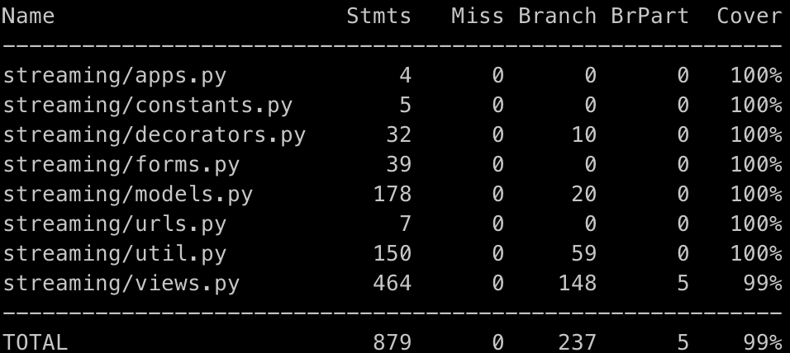
Testing
Coverage Testing :
Python Coverage Package
100% Statement
98% Branch
Use Case Testing :
Not Exhaustive | Pass | Total
8 | 144 | 152

Slide 10
Challenges
Inefficient meetings initially (30+ minutes)
Unfamiliarity with technology
Had to extensively read documentation before creating content
Initially used multiple JWPlayer accounts
Caused problems later in development with the JWPlayer API due to having multiple keys
Notes:
Resuming Media Playback
Media was initially uploaded to several different JW Accounts
Each account has a different unique private key to make API requests
Resuming Video Playback requires the same unique key across all media
Solution: The accounts had to be merged into a single account to all have the same key

